Slide 1
Learning Partners:
The ‘How’
Presented by: Alice Thornton
Date: 04.07.2023

Slide 2
How do you commission a learning partner?
A good learning partner will guide you through a process, responding to your organisation’s learning needs and aspirations. This is not the same as developing a ‘product’…
… and this has implications for how you commission and contract with a learning partner.
Process
Product
Notes:
Note that all of my suggestions on the following slides are just suggestions from my experience. They won’t necessarily work in every context – organisations and their learning aspirations/needs can be very different. But hopefully there are at least some ideas there which you might find useful.

Slide 3
Top tips: Before you commission a learning partner
Make sure you know the answers to these questions:
Why do you want to learn?
What do you want to learn about?
Who is the learning for?
(You might also have ideas about how you want to learn, but that isn’t essential. A good learning partner can help you with this part).
Make sure you – and your colleagues – are clear that you can’t outsource learning. You have to do it yourself.
A good learning partner will act as a guide but they can’t ‘do’ the learning for you.
This means that you have to be willing and able to put enough time and headspace into the learning partnership to make it work.

Slide 4
Top tips: The commissioning process
Allow enough flexibility in the commissioning process to let potential learning partners show you what they’re really like to work with.
Try allowing any submission format (e.g. written, videos, slides etc) – this will give you a better sense of their preferred style (and makes shortlisting more fun).
Try to avoid being too prescriptive (e.g. about length, content, format) – this will also allow space for different styles to shine through.
A good relationship fit is probably more important than specific experience. Make sure your requirements include what you are looking for in terms of:
Skills and attributes as well as experience.
Subject or grounded knowledge as well as methodological knowledge.

Slide 5
Top tips: How to design a learning partner contract
As far as possible, try to make sure the ITT and contract talk the same language.
E.g. try to avoid having an ITT focusing on flexibility and relationships, with a contract expecting specific milestones delivered in a specific way at specific times.
Try to embed flexibility into the budget and payment schedule. For example:
You may want to focus more on day rates and days committed by different team members, rather than the cost of specific deliverables.
Try structuring the payment schedule around time spent rather than specific deliverables.

Slide 6
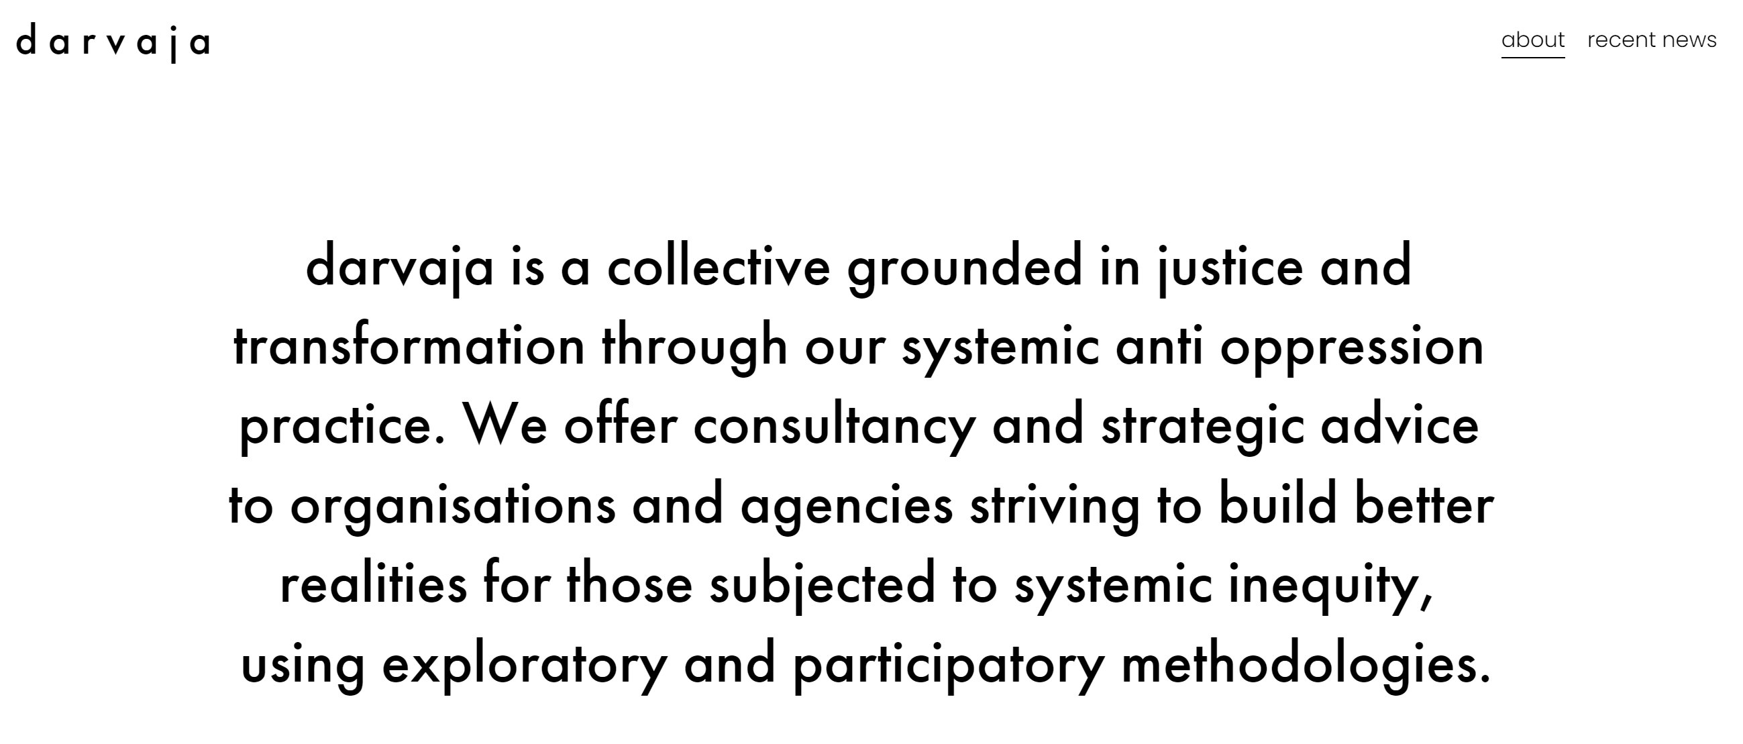
Two learning partners: darvaja and Class13

Slide 7
Thank you
Impact on Urban Health Unlocking the potential for cities to be healthier
Urbanhealth.org.uk @ImpUrbanHealth

